Slide 1



Introduction to the Dart Programming Language
by Todd Nash

Slide 2
Challenges Dart Tries to Solve
Large scale application development in JavaScript traditionally required a heroic effort.
JavaScript (at the time) lacked structuring mechanisms, tools, editors, code analyzers. Although, JS has improved with ESlint, JSHint, build tools (webpack), package managers (npm & yarn). ES6 has enables classes and a module system.
Ways in which JavaScript community has tried to solve the problem:
JavaScript Frameworks and Libraries - jQuery, Backbone, Knockout, Angular, React, Ember, Aurelia, Bootstrap etc. (the list goes on...)
Supersets of JavaScript that trans-compiles to JavaScript - CoffeeScript, TypeScript, etc.
Completely different languages that compiles to JavaScript - GWT (compiles Java to JS), Pyjamas (Python to JS), Dart.
Notes:
Lint is the computer science term for a static code analysis tool used to flag programming errors, bugs, stylistic errors and suspicious constructs. The term originates from a Unix utility that examined C language source code. A program which performs this function is also known as a "linter".

Slide 3

Dart Salaries
Dart developer salaries are growing! They are, however, still among the lowest-paid. This is likely because Dart is relatively new and not a lot of senior developers. Irregardless, it is still a very versatile and advanced programming language.
Dart was created in order to solve the problems of JavaScript. It seems that Google engineers were frustrated with maintaining massive JavaScript code bases for Gmail and Google Maps, this is why they began working on alternative languages. When Dart was first developed, it was not widely used. Adoption is growing!
Notes:
Dart and SAS saw the highest increase in median pay during 2023, growing more than 20% year-over-year.

Slide 4
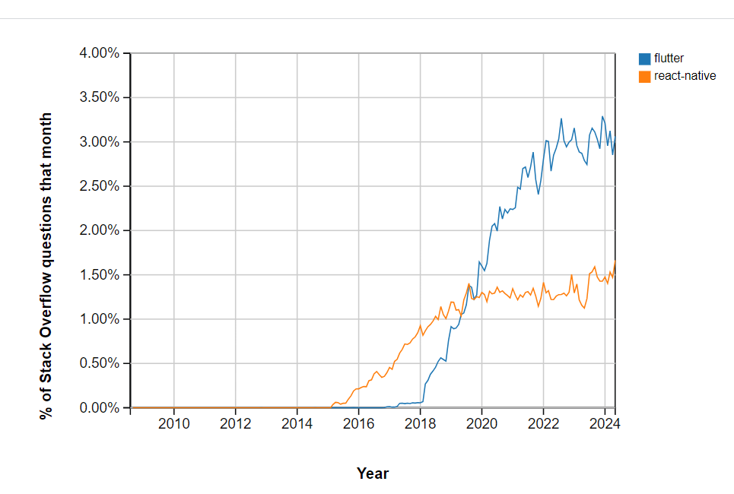
Frequency of Use
Thanks to the Flutter framework, it is tailored for writing cross-platform applications, and on-the-go code compilation makes Dart an ideal language for mobile development.
Moreover, its graphics written in C/C ++ has a steadily high performance, consistently delivering 60 frames per second, and on devices with the use of Flutter up to 120 frames per second. These features have already made Dart an adorable language among developers, having Flutter framework overtaken React Native in the frequency of use.

Slide 5
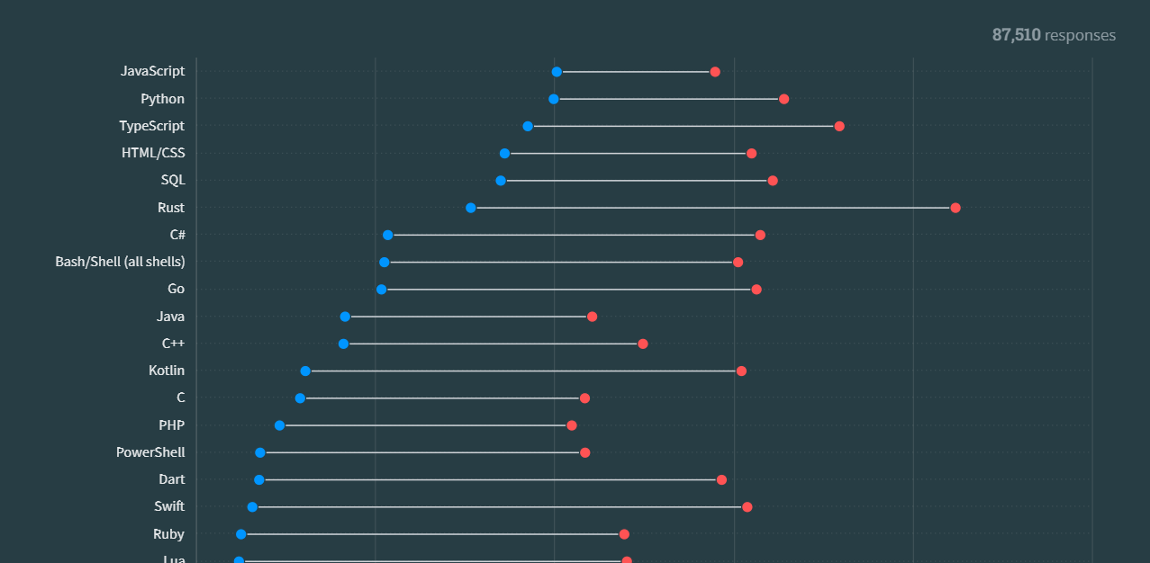
Admired and Desired (2023 Stack Overflow Developer Survey)

Slide 6
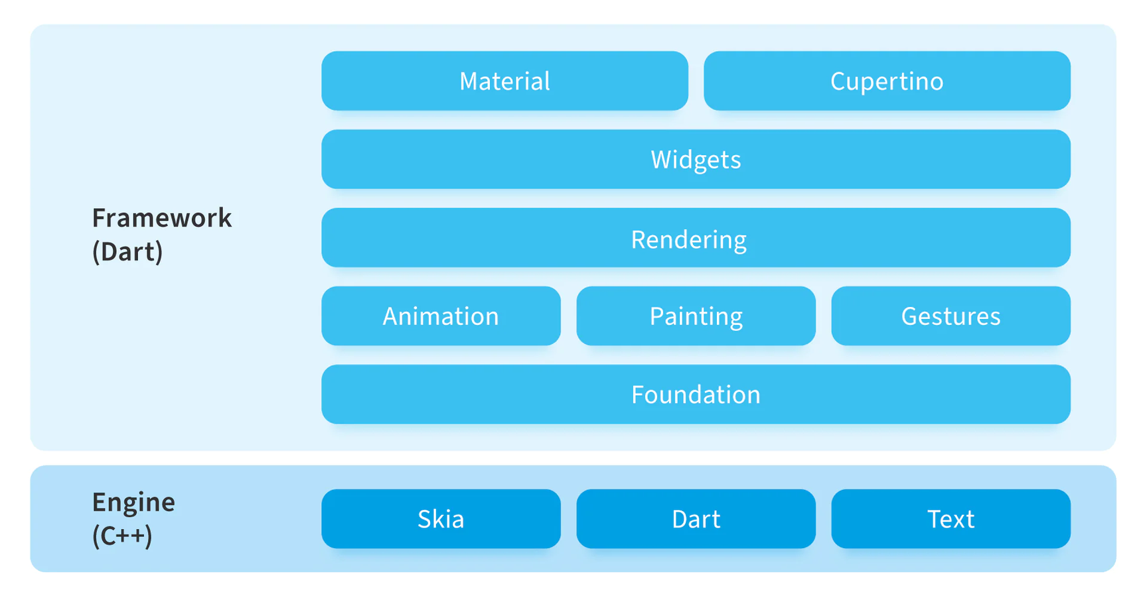
Goal of Dart
Help app developers write complex, high fidelity client apps for mobile and the modern web.
by Todd Nash

Slide 7
Dart is...
...for scalable, productive app development.
...an open-source, scalable programming language, with robust libraries and runtimes, for building web, server, and mobile apps.
Dart is class based, purely object oriented, dynamic language with C-style syntax descendant in the ALGOL language family alongside C, Java, C#, JavaScript, and others. It is purely object-oriented (similar to Smalltalk, Ruby and Scala) - so even basic types (int, float) are objects.
Supports:
optional static typing and type checks (with null safety)
single inheritance with support for mixins
real lexical scoping and closures
asynchronous & isolate operations
*Dart is heavily influenced by JavaScript, Java and C#, so it becomes familiar to both JavaScript developers and Java/C# developers immediately.
What is Dart?
by Todd Nash
Notes:
ALGOL (short for ALGOrithmic Language) is a family of imperative computer programming languages originally developed in the mid-1950s. It is historically significant for being the first language to introduce several key concepts that have influenced many modern programming languages.
Blocks and Scope: ALGOL introduced the concept of block structure, where blocks of code can have their own scope for variables. This laid the foundation for structured programming.
Syntax and Semantics:
Readable Syntax: ALGOL's syntax was designed to be readable and resemble mathematical notation.
Control Structures: It included control structures such as if-then-else, for loops, and while loops, which have become standard in many later languages.

Slide 8
What is Dart?
Lexical Scoping Functions can see and use variables from their parent functions.
Closures
Functions keep access to variables from the place they were created, even if the parent function is done running.
DART FEATURES
Supports single inheritance, meaning a class can only inherit from one superclass. However, Dart allows you to use mixins to reuse code across multiple classes.
Supports asynchronous programming with async, await, and Future. This allows you to write non-blocking code, handling tasks like I/O operations.
Dart uses isolates for concurrency. Isolates are independent workers that don’t share memory but can communicate via messages.
Statically typed & null safety to minimize errors.
by Todd Nash
Notes:
Facilitates non-blocking code and concurrency, making Dart suitable for both single-threaded and multi-threaded environments.
Dart offers advanced class features including mixins for code reuse across classes, abstract classes for defining interfaces with unimplemented methods, and factory constructors for controlling object creation.
Named constructors provide multiple ways to instantiate a class, while extension methods allow adding new functionality to existing classes. Generics enable type-safe code that can work with any data type, and abstract methods ensure subclasses implement specific methods.
These features enhance code flexibility, reusability, and organization.

Slide 9
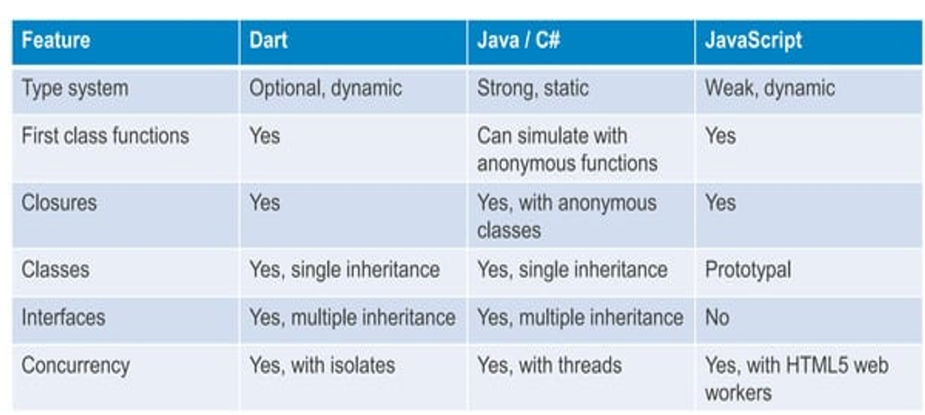
What is Dart?
Influenced by strongly typed languages like Java & C#, and loosely typed dynamic languages like JavaScript.
by Todd Nash

Slide 10
Basic Concepts
• Everything you can place in a variable is an object, and every object is an instance of a class. Even numbers, functions, and null are objects. All objects inherit from the Object class.
• Specifying static types clarifies your intent and enables static checking by tools.
• Dart parses all your code before running it. You can provide tips to Dart-for example, by using types or compile-time constants-to catch errors or help your code run faster.
• Dart supports top-level functions (such as main()), as well as functions tied to a class or object (static and instance methods, respectively). You can also create functions within functions (nested or local functions).
Similarly, Dart supports top-level variables, as well as variables tied to a class or object (static and instance variables). Instance variables are sometimes known as fields or properties.
by Todd Nash
Notes:
Top-level variables are variables declared directly within a Dart library or file, not inside a class or function.
Global Scope: These variables are accessible from any code within the same library (or file).
Initialization: They are initialized once when the library is loaded.
Top-level functions are functions defined directly within a Dart library or file, not inside a class.
Global Scope: These functions are accessible from any code within the same library (or file).
Usage: Useful for utility functions or code that doesn’t logically belong to a specific class.

Slide 11
Basic Concepts
• Unlike Java, Dart doesn't have the keywords public, protected, and private. If an identifier starts with an underscore (_), it's private to its library. For details, see Libraries and visibility.
• Identifiers can start with a letter or, followed by any combination of those characters plus digits.
• Sometimes it matters whether something is an expression or a statement, so we'll be precise about those two words.
• Dart tools can report two kinds of problems: warnings and errors. Warnings are just indications that your code might not work, but they don't prevent your program from executing. Errors can be either compile-time or run-time. A compile-time error prevents the code from executing at all; a run-time error results in an exception being raised while the code executes.
by Todd Nash

Slide 12
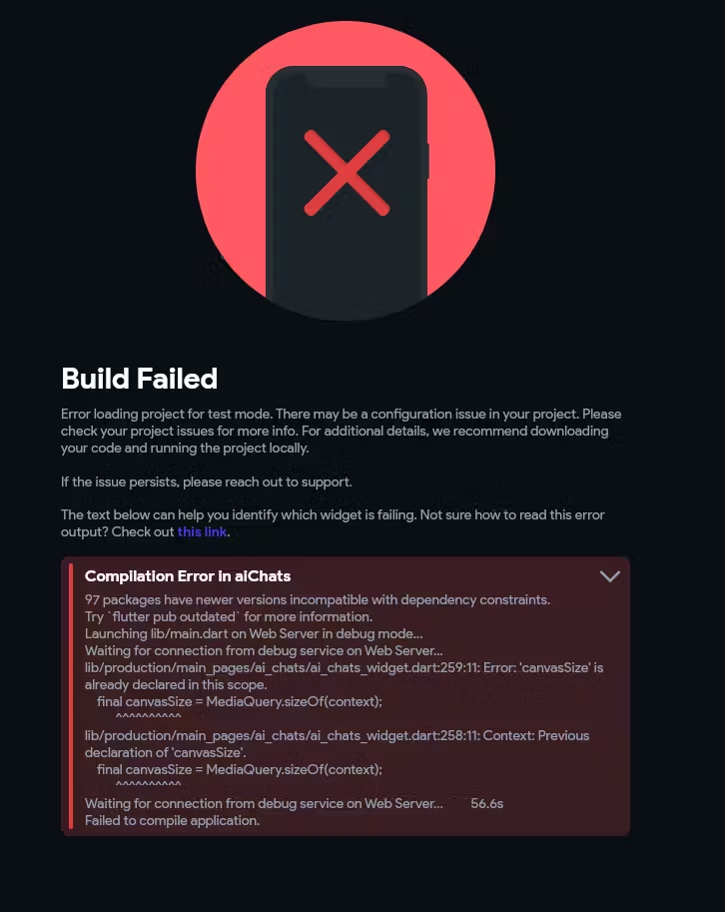
Modes
Dart has two runtime modes: production and checked. We recommend that you develop and debug in checked mode, and deploy to production mode.
Production mode is the default runtime mode of a Dart program, optimized for speed. Production mode ignores assert statements and static types.
Checked mode is a developer-friendly mode that helps you catch some type errors during runtime. For example, if you assign a non-number to a variable declared as a num, then checked mode throws an exception.
by Todd Nash
Notes:
That's why when an app runs in the Dart Virtual Machine (VM), it can do so in two runtime modes:
The Checked mode: This is also known as the debug mode. The checked mode is used during development and gives you warnings and errors of possible bugs in the code.
The Production mode: This is also known as the release mode.

Slide 13
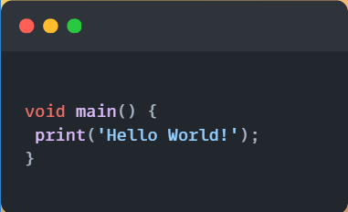
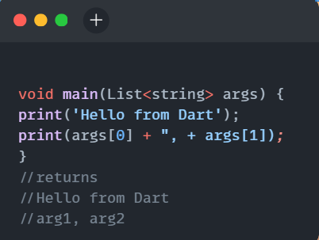
Basics - First Dart Program
•main() - The special, required, top-level function where app execution starts. Every app must have a top-level main() function, which serves as the entry point to the app
• Returns void (no return value) and has an optional List<String> parameter for arguments.
by Todd Nash
Notes:
Explicitly typed and returns a list of string arguments.
void: Indicates that the main function does not return any value. It’s used when the function performs operations but does not need to return any result.
main: The name of the function that serves as the starting point of the Dart program. The Dart runtime looks for this function to begin execution.

Slide 14
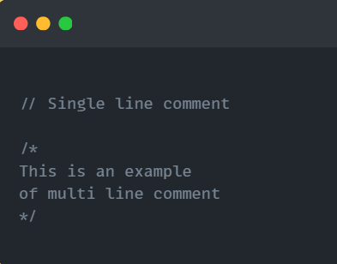
Comments
Dart supports both single line and multi line comments.
by Todd Nash
Notes:
Explicitly typed and returns a list of string arguments.

Slide 15
Variables
Variables can be declared using the var keyword, similar to JavaScript.
Variables are references.
Uninitialized variables have an initial value of null. Even variables with numeric types are initially null, because numbers are objects.
“late” variables
The late keyword is used for variables that are initialized after their declaration but are guaranteed to be initialized (assigned values) before use.
“final” variables
The final keyword is used for variables whose value can be set only once and cannot be changed after initialization.
“const” variables
The const keyword is used for compile-time constants. Variables declared with const must be initialized with a value known at compile time and cannot be changed.
by Todd Nash
Notes:
In Dart, when we say that variables are references, it means that variables store references (or pointers) to objects rather than the objects themselves.
When you use a variable to store something like a list or an object, the variable doesn't hold the actual list or object. Instead, it holds a pointer or address to where the list or object is kept in memory.

Slide 16
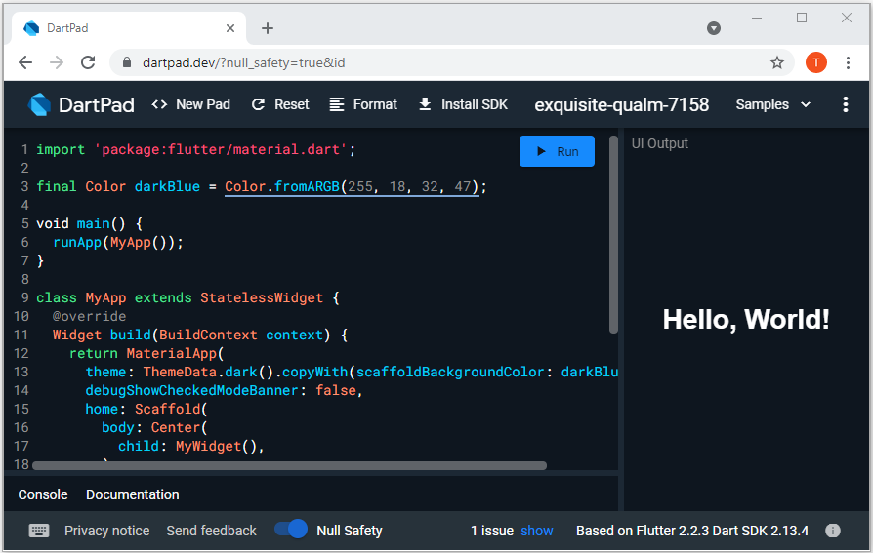
Time to begin the code labs & learning more advanced concepts with DartPad.
Now that you know a little about the Dart programming language, it is time to complete the rest of the module content! Be sure to check out the cheat sheet for a quick reference guide on Dart syntax.
by Todd Nash

